Slide 1
FACTORscore使用说明

Slide 2

FACTORscore 参考文献

Slide 3
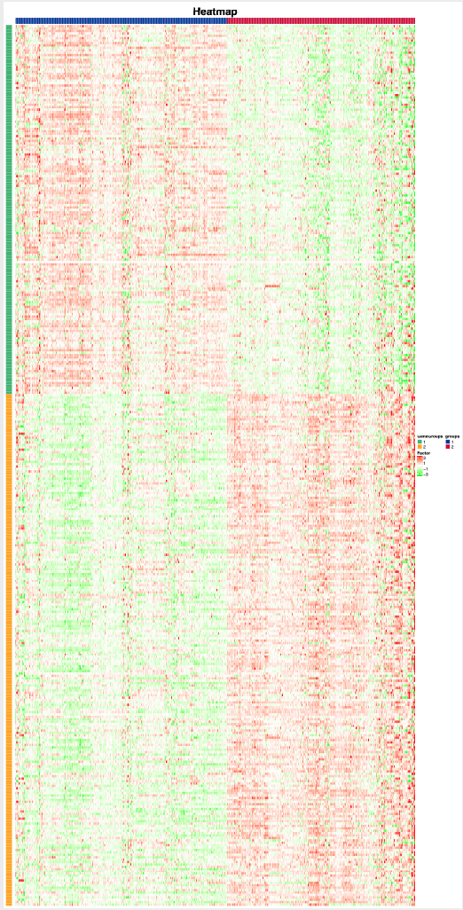
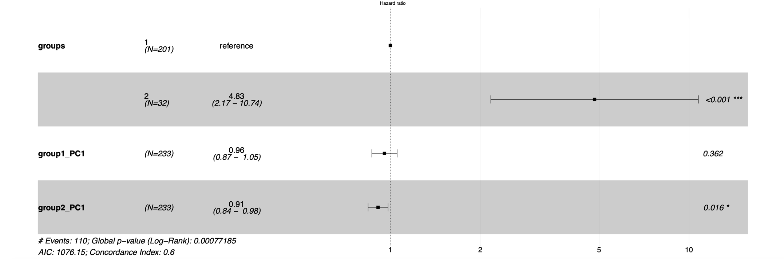
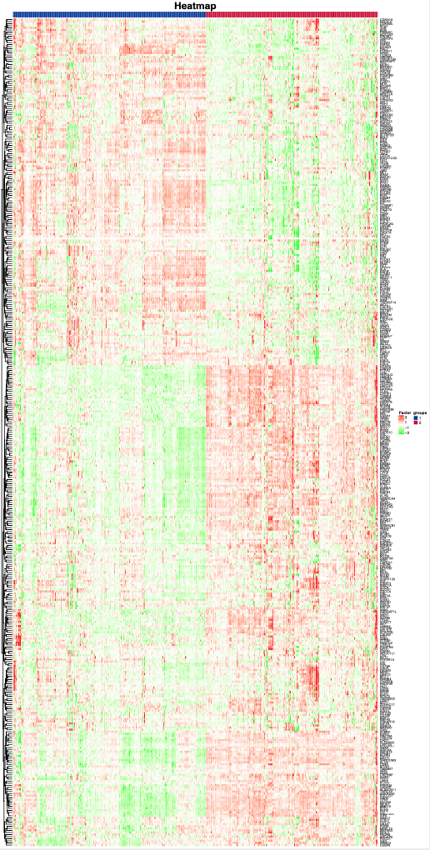
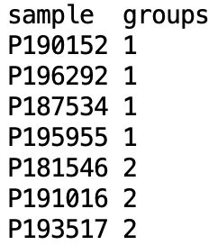
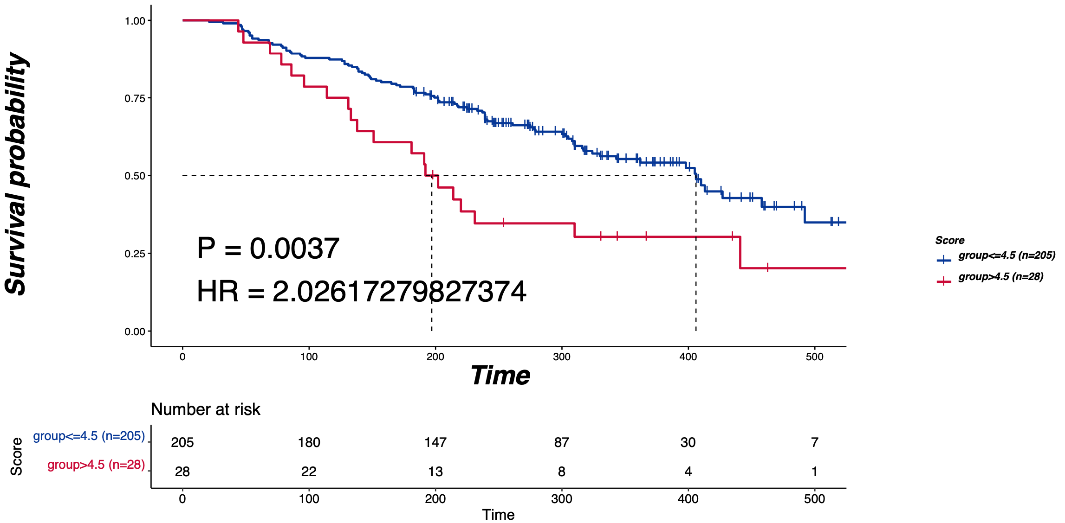
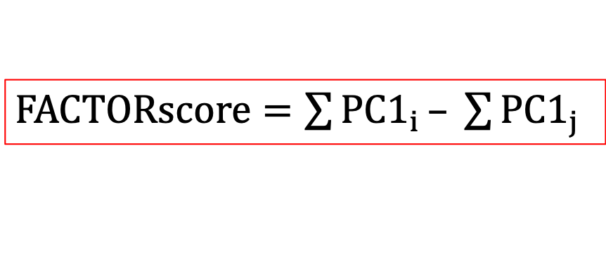
FACTORscore 原 理
输入
cluster
group
Diff
Analysis
CNV.txt/RNA.txt
Time.txt
Outdir
Prefix(输出结果前缀)
[-f TR/T]
cluster
PC1
Wilcox
2组
KW
3-6组
$FACTORscore=\sum{PC1_{i}}– \sum{PC1_{j}}$
输出
GeneGroup=*.PC1
GeneGroup=*.Score
Score_forest.pdf
Score_svv.pdf
Score_survival.HR.pval.xls

Slide 4
输入文件格式
CNV数据
sample | ACAP3 | ACTRT2 | AGRN | ANKRD65 | ATAD3A | ATAD3B | ATAD3C | AURKAIP1 | B3GALT6 | C1orf159 | C1orf233 | C1orf86 | CALML6
TCGA-2J-AAB1-01 | 0.007 | 0.007 | 0.007 | 0.007 | 0.007 | 0.007 | 0.007 | 0.007 | 0.007 | 0.007 | 0.007 | 0.007 | 0.007
TCGA-2J-AAB4-01 | 0.051 | 0.051 | 0.051 | 0.051 | 0.051 | 0.051 | 0.051 | 0.051 | 0.051 | 0.051 | 0.051 | 0.051 | 0.051
TCGA-2J-AAB6-01 | 0.469 | 0.469 | 0.469 | 0.469 | 0.469 | 0.469 | 0.469 | 0.469 | 0.469 | 0.469 | 0.469 | 0.469 | 0.469
TCGA-2J-AAB8-01 | -0.079 | -0.079 | -0.079 | -0.079 | -0.079 | -0.079 | -0.079 | -0.079 | -0.079 | -0.079 | -0.079 | -0.079 | -0.079
TCGA-2J-AAB9-01 | -0.038 | -0.038 | -0.038 | -0.038 | -0.038 | -0.038 | -0.038 | -0.038 | -0.038 | -0.038 | -0.038 | -0.038 | -0.038
TCGA-2J-AABA-01 | -0.351 | -0.351 | -0.351 | -0.351 | -0.351 | -0.351 | -0.351 | -0.351 | -0.351 | -0.351 | -0.351 | -0.351 | -0.351
TCGA-2J-AABE-01 | 0 | 0 | 0 | 0 | 0 | 0 | 0 | 0 | 0 | 0 | 0 | 0 | 0
TCGA-2J-AABF-01 | 0.16 | 0.16 | 0.16 | 0.16 | 0.16 | 0.16 | 0.16 | 0.16 | 0.16 | 0.16 | 0.16 | 0.16 | 0.16
TCGA-2J-AABH-01 | -0.484 | -0.484 | -0.484 | -0.484 | -0.484 | -0.484 | -0.484 | -0.484 | -0.484 | -0.484 | -0.484 | -0.484 | -0.484
TCGA-2J-AABI-01 | -0.659 | -0.659 | -0.659 | -0.659 | -0.659 | -0.659 | -0.659 | -0.659 | -0.659 | -0.659 | -0.659 | -0.659 | -0.659
TCGA-2J-AABK-01 | -0.097 | -0.097 | -0.097 | -0.097 | -0.097 | -0.097 | -0.097 | -0.097 | -0.097 | -0.097 | -0.097 | -0.097 | -0.097

Slide 5
输入文件格式
RNA数据
以基因为单位进行定量
sample | A2M | ABCC4 | ABCC4 | ACO1 | ACTA1 | ACTG1 | ACTG1 | ACVR1B | ACVR1B
S00022 | 28.1252 | 0 | 0.717167 | 5.28921 | 0.219548 | 5.75708 | 1249.75 | 3.60E-05 | 0.577107
S00035 | 39.6673 | 0 | 0.327899 | 18.2844 | 0 | 15.9213 | 1678.37 | 0.000516 | 0.434868
S00050 | 45.7157 | 0.083023 | 0.847841 | 13.8866 | 0.586074 | 16.0569 | 1746.24 | 0.000323 | 0.191109
S00213 | 86.3615 | 0.067135 | 2.32504 | 11.4792 | 0.144963 | 12.9836 | 1624.96 | 0.36678 | 0.06388
S00356 | 125.923 | 0.042752 | 1.03902 | 10.4983 | 0.17502 | 16.5432 | 1631.65 | 0.000243 | 0.536639
S00472 | 52.2997 | 0 | 0.450526 | 11.5296 | 0.241006 | 9.59723 | 1726.84 | 1.08372 | 0.300775
S00501 | 102.643 | 1.00E-06 | 1.16147 | 19.9432 | 0.109974 | 8.88098 | 2487.67 | 3.53747 | 0.603576
S00825 | 279.722 | 0.064473 | 1.7942 | 15.6369 | 0.090447 | 16.8534 | 1915.55 | 0.926907 | 0.152819
S00827 | 75.0199 | 0.016484 | 1.57716 | 5.54777 | 0.972083 | 12.3907 | 2126.69 | 4.67447 | 0.254969
S00829 | 65.6762 | 0.160017 | 2.29181 | 13.9828 | 0.045815 | 10.9354 | 1566.92 | 0.000175 | 0.441033
S00830 | 113.817 | 0.105693 | 1.19674 | 9.22521 | 0.711353 | 18.5749 | 1555.75 | 1.97405 | 0.267088
S00831 | 142.812 | 0.119036 | 1.17589 | 16.7691 | 1.01085 | 13.0661 | 1607.1 | 5.20E-05 | 0.26518
S00832 | 48.183 | 0 | 1.17335 | 9.04858 | 0.209135 | 13.9818 | 1729.2 | 0.000171 | 0.435628

Slide 6
输入文件格式
RNA数据
以转录本为单位进行定量
sample | S00022 | S00035 | S00050 | S00213 | S00356 | S00472 | S00501 | S00825 | S00827 | S00829 | S00830 | S00831 | S00832
BECN1 | 18.4125 | 41.5829 | 25.3937 | 38.2477 | 32.6969 | 24.6955 | 35.0205 | 36.9264 | 17.8884 | 31.7728 | 22.5791 | 31.2433 | 27.603
BID | 7.76943 | 8.41666 | 5.95215 | 17.9174 | 7.57507 | 6.5563 | 15.3067 | 7.69691 | 14.5914 | 6.26763 | 8.19738 | 7.08261 | 4.56428
BID | 0.823616 | 0.626221 | 0.405686 | 3.22656 | 0.605345 | 0 | 1.20858 | 0.969182 | 1.08822 | 0.800949 | 0.298918 | 0.419902 | 0.981241
BID | 1.70E-05 | 0.127082 | 1.30E-05 | 8.60E-05 | 1.00E-05 | 1.54385 | 7.00E-06 | 3.20E-05 | 4.00E-06 | 3.40E-05 | 3.00E-06 | 1.60E-05 | 8.30E-05
BID | 0.228081 | 0.185037 | 0.24901 | 2.02862 | 0.174092 | 0.116439 | 0.122961 | 0.161932 | 0.433112 | 0.229567 | 0.348383 | 0.048129 | 0.053719
BID | 0 | 0 | 0 | 0 | 0 | 0 | 0 | 0 | 0 | 0 | 0 | 0 | 0
BID | 1.41712 | 1.89702 | 0.239936 | 2.91676 | 0.75825 | 0.386073 | 1.09076 | 2.02535 | 1.70303 | 1.8402 | 0.840077 | 1.10038 | 0.639493
BID | 0 | 0 | 0.116342 | 0.283282 | 9.60E-05 | 0.217778 | 0.212186 | 0 | 0.034945 | 0 | 0 | 0.320977 | 0
BIRC5 | 40.4859 | 92.5416 | 32.9571 | 48.6265 | 37.2844 | 19.1797 | 27.2473 | 24.1656 | 36.4261 | 26.1887 | 14.5468 | 50.687 | 52.3991

Slide 7
输入文件格式
生存数据
sample | OS | re
S00022 | 38 | 1
S00035 | 12 | 1
S00050 | 42 | 1
S00213 | 13 | 1
S00356 | 33 | 1
S00472 | 12 | 1
S00501 | 72 | 1
S00825 | 25 | 1
S00827 | 38 | 0
S00829 | 84 | 0
S00830 | 58 | 0
S00831 | 10 | 1
S00832 | 77 | 1
S00836 | 90 | 0
S00837 | 95 | 1
S00838 | 20 | 1
S01242 | 12 | 1
S01248 | 28 | 1
S01297 | NA | NA
S01366 | 22 | 1

Slide 8
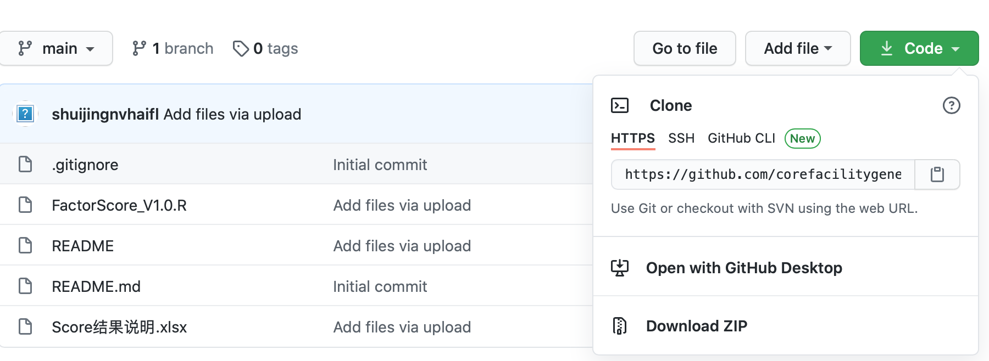
下载地址
https://github.com/corefacilitygenecast/FACTORscore

Slide 9
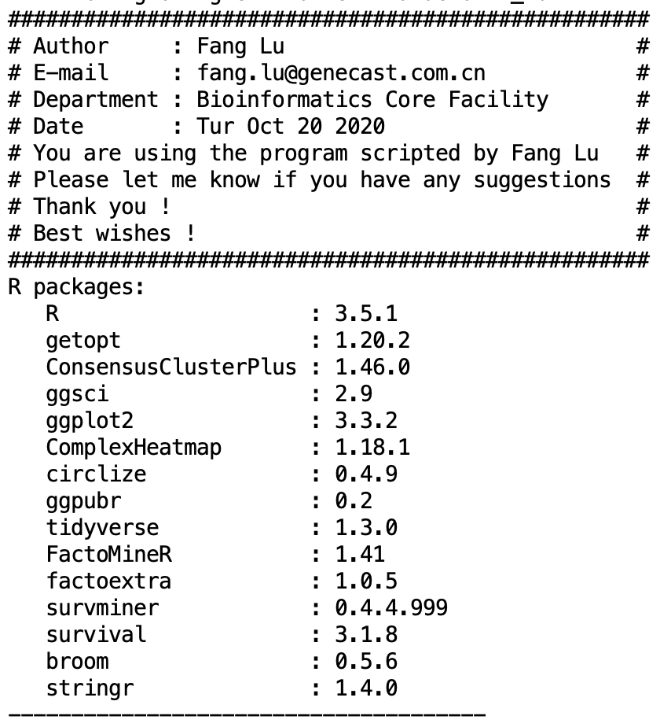
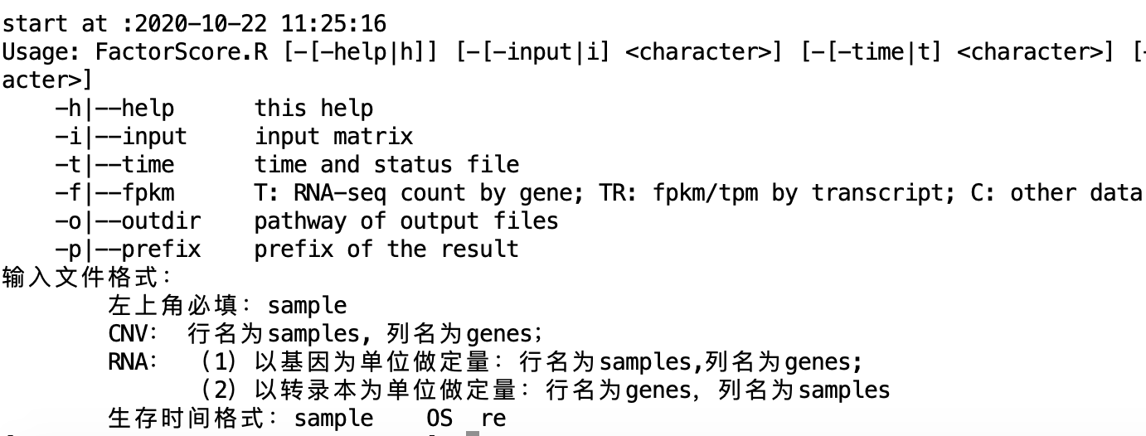
命令运行
Rscript FactorScore.R -h
Rscript FactorScore.R -i input.txt –t time.txt -o outdir -p test -f TR/T/C
R packages版本信息

Slide 10
./
├── euclidean_pam | 样本(sample)做一致性聚类的结果文件夹(算法选用euclidean_pam)
│ ├── consensus.pdf | K=2-6取值的consesuscluster聚类结果，*.consensusClass.csv是分组的结果(以“,"分割）， *.consensusMatrix.csv是矩阵信息， *.group是将consensusClass.csv提取出来以\t分割， *.heatmap.pdf是分组的heatmap热图
│ ├── euclidean_pam.k=2.consensusClass.csv
│ ├── euclidean_pam.k=2.consensusMatrix.csv
│ ├── euclidean_pam.k=3.consensusClass.csv
│ ├── euclidean_pam.k=3.consensusMatrix.csv
│ ├── euclidean_pam.k=4.consensusClass.csv
│ ├── euclidean_pam.k=4.consensusMatrix.csv
│ ├── euclidean_pam.k=5.consensusClass.csv
│ ├── euclidean_pam.k=5.consensusMatrix.csv
│ ├── euclidean_pam.k=6.consensusClass.csv
│ ├── euclidean_pam.k=6.consensusMatrix.csv
│ ├── euclidean_pam.log.csv
│ ├── test.k=2.group
│ ├── test.k=2.heatmap.pdf
│ ├── test.k=3.group
│ ├── test.k=3.heatmap.pdf
│ ├── test.k=4.group
│ ├── test.k=4.heatmap.pdf
│ ├── test.k=5.group
│ ├── test.k=5.heatmap.pdf
│ ├── test.k=6.group
│ └── test.k=6.heatmap.pdf
├── test_data_nrom.txt | 输入的文件标准化之后的结果
│ ├── k=* | sample分组为2-6时，对基因进行一致性聚类分析
│ │ ├── euclidean_pam | 同样本的一致性聚类分析结果，基因聚类分为2-6组时的结果
│ │ │ ├── consensus.pdf
│ │ │ ├── euclidean_pam.k=2.consensusClass.csv
│ │ │ ├── euclidean_pam.k=2.consensusMatrix.csv
│ │ │ ├── euclidean_pam.k=3.consensusClass.csv
│ │ │ ├── euclidean_pam.k=3.consensusMatrix.csv
│ │ │ ├── euclidean_pam.k=4.consensusClass.csv
│ │ │ ├── euclidean_pam.k=4.consensusMatrix.csv
│ │ │ ├── euclidean_pam.k=5.consensusClass.csv
│ │ │ ├── euclidean_pam.k=5.consensusMatrix.csv
│ │ │ ├── euclidean_pam.k=6.consensusClass.csv
│ │ │ ├── euclidean_pam.k=6.consensusMatrix.csv
│ │ │ ├── euclidean_pam.log.csv
│ │ │ ├── gene_k=* | 例：sample分组为2，基因分组为2的情况下进行PCA分析及FACTOR_Score的计算
│ │ │ │ ├── ConsensusGroup_PC1_forest.pdf | 样本的不同分组的PC1的cox回归结果
│ │ │ │ ├── ConsensusGroup_PC1_summary.txt
│ │ │ │ ├── ConsensusGroup_PC1_survival.HR.pval.xls
│ │ │ │ ├── ConsensusGroup_PC1_surv_summary.txt
│ │ │ │ ├── ConsensusGroup_PC1_svv.pdf
│ │ │ │ ├── ConsensusGroup_PC1_svv.txt
│ │ │ │ ├── factor.list | 用来做cutpoint的输入文件
│ │ │ │ ├── GeneGroup=1.mat | 将不同分组的基因结果提取出来，作为PCA的输入文件
│ │ │ │ ├── GeneGroup=2.mat
│ │ │ │ ├── GeneGroup=2.PC1 | PCA的分析结果
│ │ │ │ ├── GeneGroup=2.Score | FACTOR_Score的结果，最后一列为Score值
│ │ │ │ ├── Score_forest.pdf | Score值的cutpoint结果，目前方法是maxstat的结果
│ │ │ │ ├── Score_summary.txt
│ │ │ │ ├── Score_survival.HR.pval.xls
│ │ │ │ ├── Score_svv.pdf
│ │ │ │ └── Score_svv.txt
│ │ │ ├── gene_k=2.group | 基因一致性聚类得到的分组结果
│ │ ├── wilcox/KW_sig_gene.mat | wilcox/KW检验得到差异基因，并提取对应的信息
│ │ ├── wilcox/KW_sig_gene.txt
│ │ └── Normalized.data.xls | z-score之后的数据
结果说明

